Slide 1
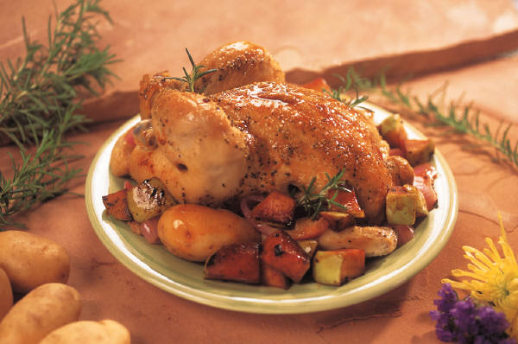
PREPARE AND COOK POULTRY AND GAME MEATS
D1.HCC.CL2.09
Notes:
Trainer to welcome students to class

Slide 2
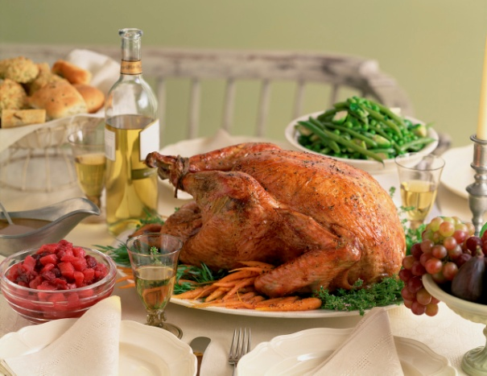
Prepare and Cook Poultry and Game Meats
Element 1: Identify and select poultry and game meats
Element 2: Prepare poultry and game meats
Element 3: Cook, hold and present
Element 4: Store poultry and game meats
Notes:
Trainer advises students this Unit comprises four Elements, as listed on the slide explaining:
Each Element comprises a number of Performance Criteria which will be identified throughout the class and explained in detail
Students can obtain more detail from their Trainee Manual
The course presents advice and information but where their workplace requirements differ to what is presented, the workplace practices and standards must be observed.

Slide 3

Prepare and Cook Poultry and Game Meats
Assessment for this Unit may include:
Oral questions
Written questions
Work projects
Workplace observation of practical skills
Practical exercises
Formal report from employer/supervisor
Notes:
Trainer advises students that assessment for this Unit may take several forms all of which are aimed at verifying they have achieved competency for the Unit as required.
Trainer indicates to students the methods of assessment that will be applied to them for this Unit.

Slide 4
Prepare and Cook Poultry and Game Meats
Element 1: Identify and select poultry and game meats
Identify varieties of poultry and game
Identify commercial establishment cuts and specifications
Identify and select suppliers for purchasing of products
Minimize wastage through freshness and correct purchasing
Identify costs through yield testing
Ensure correct conditions are maintained for freshness and quality
Notes:
Trainer to discuss performance criteria required tor Element 1
The element is the skill
To assess competency in the skill; the performance criteria is used to outline activities that can be used to assess competency.
The trainer should relate how the performance criteria is related to the element
To prove competency in Prepare and Cook poultry game meats the student has to be able to; Identify and select poultry and game meats
The students need to be able to;
Identify different varieties of poultry and game
Identify commercial establishment cuts and defined specifications
Identify and select supplier to supply enterprise with commodities
Minimise wastage through freshs and correct purchasing
Identify costs through yield testing
Ensure correct conditions are maintained for freshness and quality.

Slide 5
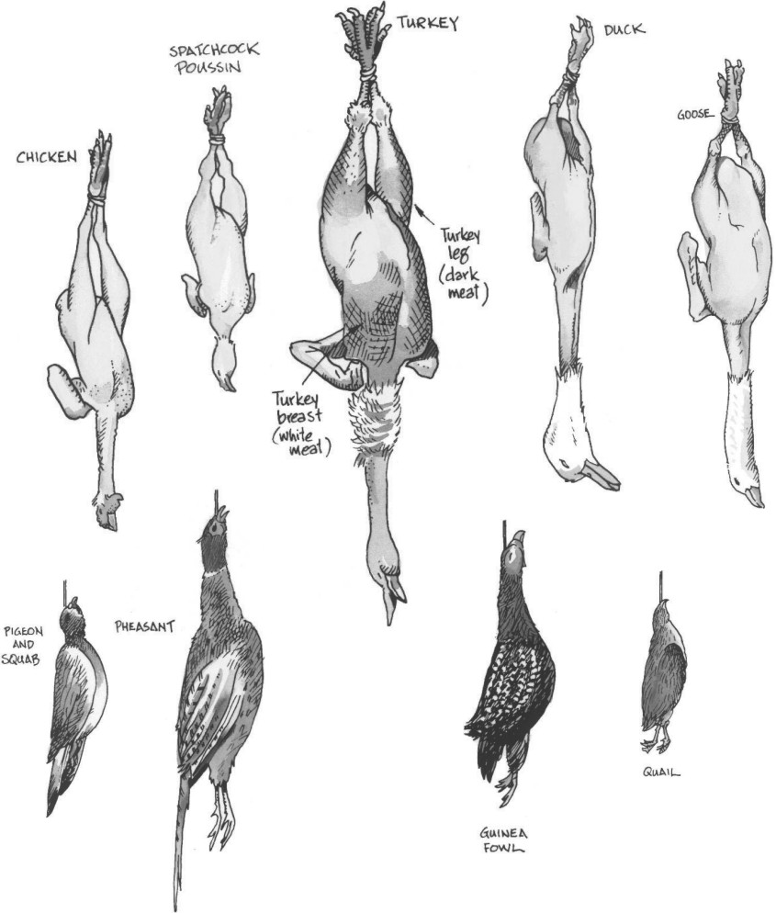
Indentify varieties of poultry and game
Poultry
Chicken
Duck
Quail
Baby chicken, (poussin)
Squab, (pigeon)
Notes:
Trainer to discuss points relative to the ‘normal’ poultry that is found in the country in which this program is being delivered.
Activity: Get the students to discuss what type of poultry that they see in the marketplace.
Define poultry as something that is available all the time.
Special poultry is only eaten on special occasions
Wild game birds have to be hunted for, not grown by a business.

Slide 6
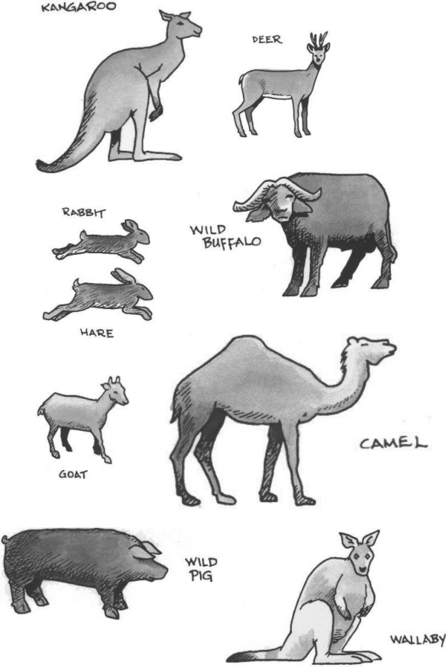
Indentify varieties of poultry and game
Game
Crocodile
Wild duck
Snake
Pig
Other wild meats
Notes:
Trainer to discuss what is considered ‘game’ in the country that this unit is being delivered.
Game: wild birds and animals that are not normally grown for human consumption, need to be hunted.
It will vary from country to country.
Activity: Get the students to discuss what they can see in the marketplace that is commonly available to the restaurant industry as ‘GAME”. It will vary from country to country.
Is it safe to consume? Is it legal?

Slide 7
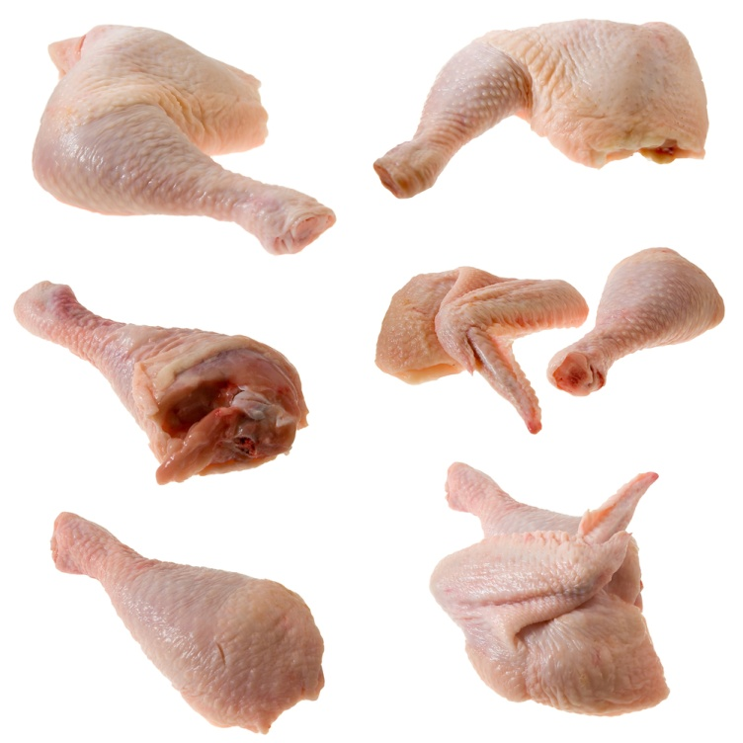
Common Commercial cuts
Commonly available cuts
Legs
Breast
Sides and saddles
Legs
Drumstick
Thighs
Cutlets.
Notes:
Trainer to discuss:
What is commonly available in the local market place
Changing and emerging trends locally
Changing and emerging trends overseas

Slide 8
Identify and select suppliers
Suppliers
Wholesalers
Retailers
Proximity to YOUR business
Purchasing requirements of supplier
YOUR purchasing needs
Seasonal purchasing requirements
Notes:
Trainer to discuss:
What is the best type of supplier for you to engage?
Needs
Purchasing requirements
Delivery requirements.

Slide 9
Minimise wastage
Efficient purchasing
Only what you need
Storage capacity of enterprise
Skill level of staff
Cost of storage
Notes:
Trainer to discuss:
Purchase only what you need.
Pointless buying the whole bird/animal if you do not have the need for the whole of the carcass
Do not purchase more because it is cheaper to buy in bulk
Be sure you can store what you purchase
Does the enterprise have the capacity to store what you purchase
Skill level
Does the staff have the skill level to ‘bone chicken’?
Cost of Storage
Space
Electricity to run equipment

Slide 10
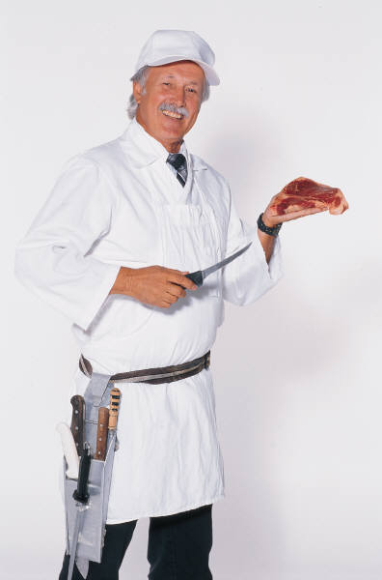
Identify costs and yield testing
Cost of cutting meat yourself:
Labour cost
How many portions do you get from each bird/animal?
Each recipe needs to get same number of sales
Different size animal ea/kg is not good method of purchasing.
Notes:
Trainer to discuss:
Each cook needs to be able to apply cost to recipe to make sure that profit margins are maintained.
25-35% food cost: Industry average

Slide 11
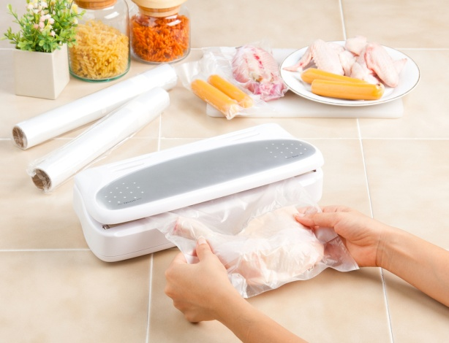
Ensure freshness and quality
Keep chilled
Do not store for more than 3 days
Protect from contamination
Date and label
Notes:
Trainer to discuss following points with students:
Purchase only what you need
Store chilled
Cover and label food
First in First out proc
Trainer to check on Work projects of Students

Slide 12
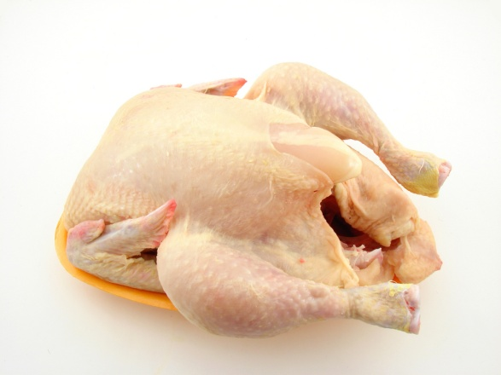
Prepare and Cook Poultry and Game Meats
Element 2: Prepare poultry and game meats
Prepare and portion poultry and game meat cuts, to enterprise requirements
Minimize wastage through preparation and storage
Use of trimmings and leftovers
Identification and use of equipment
Notes:
Trainer to discuss performance criteria required tor Element 2
The element is the skill
To assess competency in the skill; the performance criteria is used to outline activities that can be used to assess competency.
The trainer should relate how the performance criteria is related to the element

Slide 13
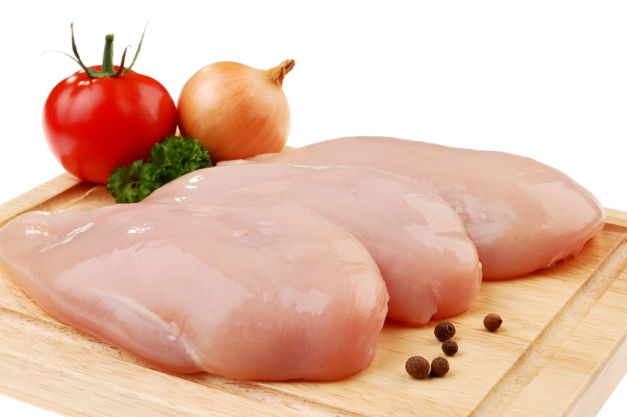
Prepare and portion cuts
Enterprise standards:
Is the skin left on
What size to cut meat
All the same weight
Same number per serve
Notes:
Trainer to discuss:
What are the standards with each enterprise?
How many pieces in a serve?
How heavy?

Slide 14
Minimise wastage
Correct cutting
Portion control
Correct storage of raw product
Correct storage of cooked product
Notes:
Trainer to discuss:
Control in preparation is important to minimise wastage
Skill level needs to be adhered to.

Slide 15
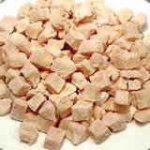
Use of trimmings
Can this be used for anything?:
Meat trimmings used in stocks
Meat trimmings used for other products
Minced for other dishes
Notes:
Trainer to discuss:
Value adding to leftover product to generate income to enterprise

Slide 16
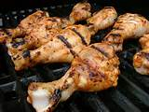
Identify and use equipment
Equipment needs:
What is a grill?
What is an induction cooker?
What is a steamer?
What is a cleaver?
How do they operate?
Am I operating this equipment correctly?
Notes:
Trainer to discuss:
To be able to cook specific dishes the cook needs to be able to carry out all the processes.
If the grill cannot be operated correctly the losses will occur:
Induction cooking
Sous vide cooking.
New methods of cooking mean new methods equipment, new skill needed by staff.
New equipment???
Staff need to be trained:
To prevent injuries and
To prevent loss of product due to lack of knowledge in how equipment operates.
Check students progress with work projects

Slide 17
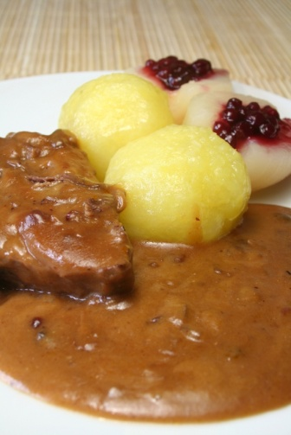
Prepare and Cook Poultry and Game Meats
Element 3: Cook hold and present
Select appropriate cooking method for poultry and game meats
Prepare and cook a selection of dishes following a standard recipes within a commercial environment
Hold prepared products as required prior to presenting
Present poultry and game meats
Prepare garnishes, sauces and accompaniments for poultry and game meat dishes
Notes:
Trainer to discuss performance criteria required for Element 3
To prove competency in Prepare and Cook poultry game meats the student has to be able to; Cook; Hold and Present these meats
Cook; apply heat to make meats more easily digestible for humans
Hold; to keep food until it is required to served to customer; Normally it is held hot but it might have to be held cold; depending on the recipe
Present; serve to customer; how the meat is placed onto the plate
The Students need to be able to;
Select appropriate cooking style for any particular poultry of game meat
Prepare a selection of dishes following standard recipes
Hold these dishes until required for service
Present these selection of poultry and game meats
Prepare garnishes
Prepare sauces
Prepare accompaniments.

Slide 18
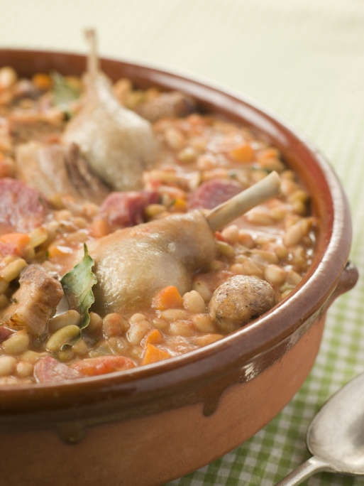
Select cooking methods
Grill, fry or poach
Tender cuts of meat
Stew, Braise, Casserole
Tough cuts of meat
Flavour required?
Ingredient reaction to cooking method
Notes:
Trainer to discuss:
Method of cooking will effect the eating quality sensation
Is the meat being grilled. Is it being marinated before grilling?
Is there sugar in marinade? If so, it will burn. Change heat setting?

Slide 19
Prepare and cook selection of dishes
Read the recipe
Understand terminology
Has it been done correctly?
Are all ingredients available?
Is the required equipment available
Notes:
Trainer to discuss:
Being prepared is half the job done
Has the recipe been read and understood
What was the end product like?

Slide 20
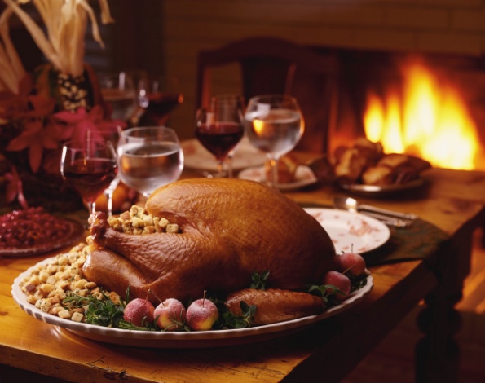
Hold prepared products
Hold hot foods hot
To be held at required temperature
How long before quality drops?
Hold cold foods cold
Have to be cooked then cooled before holding until service
Notes:
Trainer to discuss:
Foods need to be held at the required temperature
To maintain QUALITY
To maintain FOOD SAFETY
Food QUALITY and Food SAFETY go together
Keeping food hot for too long will dry it out but not make it unsafe to eat.
As it is kept hot for too long it dries out and becomes less appetising to eat.

Slide 21
Present poultry and game dishes
Plate presentation
Hot food – hot plate
Cold food – cold plate
No cracked plates
No dirty plates, must be clean
Style of presentation
All the same
Take away
Notes:
Trainer to discuss:
How food is presented will add to dining experience
Badly presented food will ruin excellent cooking and diminish the experience
Portion control: all need to be the same size.

Slide 22
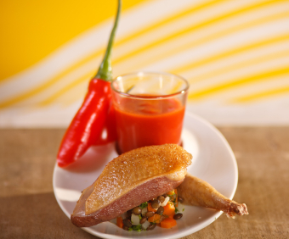
Prepare garnishes and sauces
Sauces and condiments
Compliment the dish
Do not diminish the dish
Garnishes
Fresh
Compliment the dish
Edible
Notes:
Trainer to discuss:
Finer points of above
Check students progress on Work projects.

Slide 23
Prepare and Cook Poultry and Game Meats
Element 4: Store poultry and game products
Fresh and/or vacuum packed items are stored correctly
Prepare and maintain correct thawing of poultry and game
Poultry and game is appropriately stored in correct containers
Poultry and game is correctly labelled
Ensure correct conditions are maintained for freshness and quality
Notes:
Trainer to discuss performance criteria of this element with students:
To prove competency in Prepare and Cook poultry game meats the student has to be able to;
Store poultry and game products
The students need to be able to:
Fresh and/or vacuum packed items are stored correctly
Prepare and maintain correct thawing of poultry and game
Poultry and game is appropriately stored in correct containers
Poultry and game is correctly labelled
Ensure correct conditions are maintained for freshness and quality.

Slide 24

Store fresh poultry correctly
Storage of fresh
Correct environmental temperature
Covered labeled
Length of storage time
Short term
3 days
Longer term – vacuum packed
3weeks
Notes:
Trainer to discuss:
Practicalities and difficulties of storing high risk products like fresh meats from poultry and game.

Slide 25
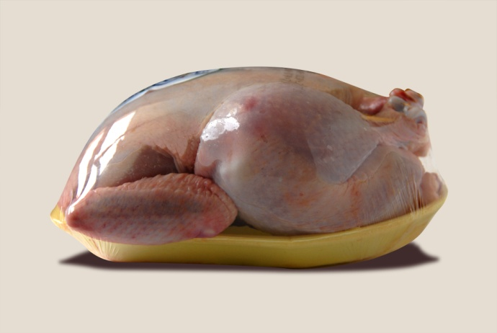
Prepare correct thawing conditions
Thawing meats:
Conditions
Covered in controlled environment
Chilled
Single layers
Use immediately.
Notes:
Trainer to discuss:
Problems with thawing frozen meats in controlled and uncontrolled environment

Slide 26
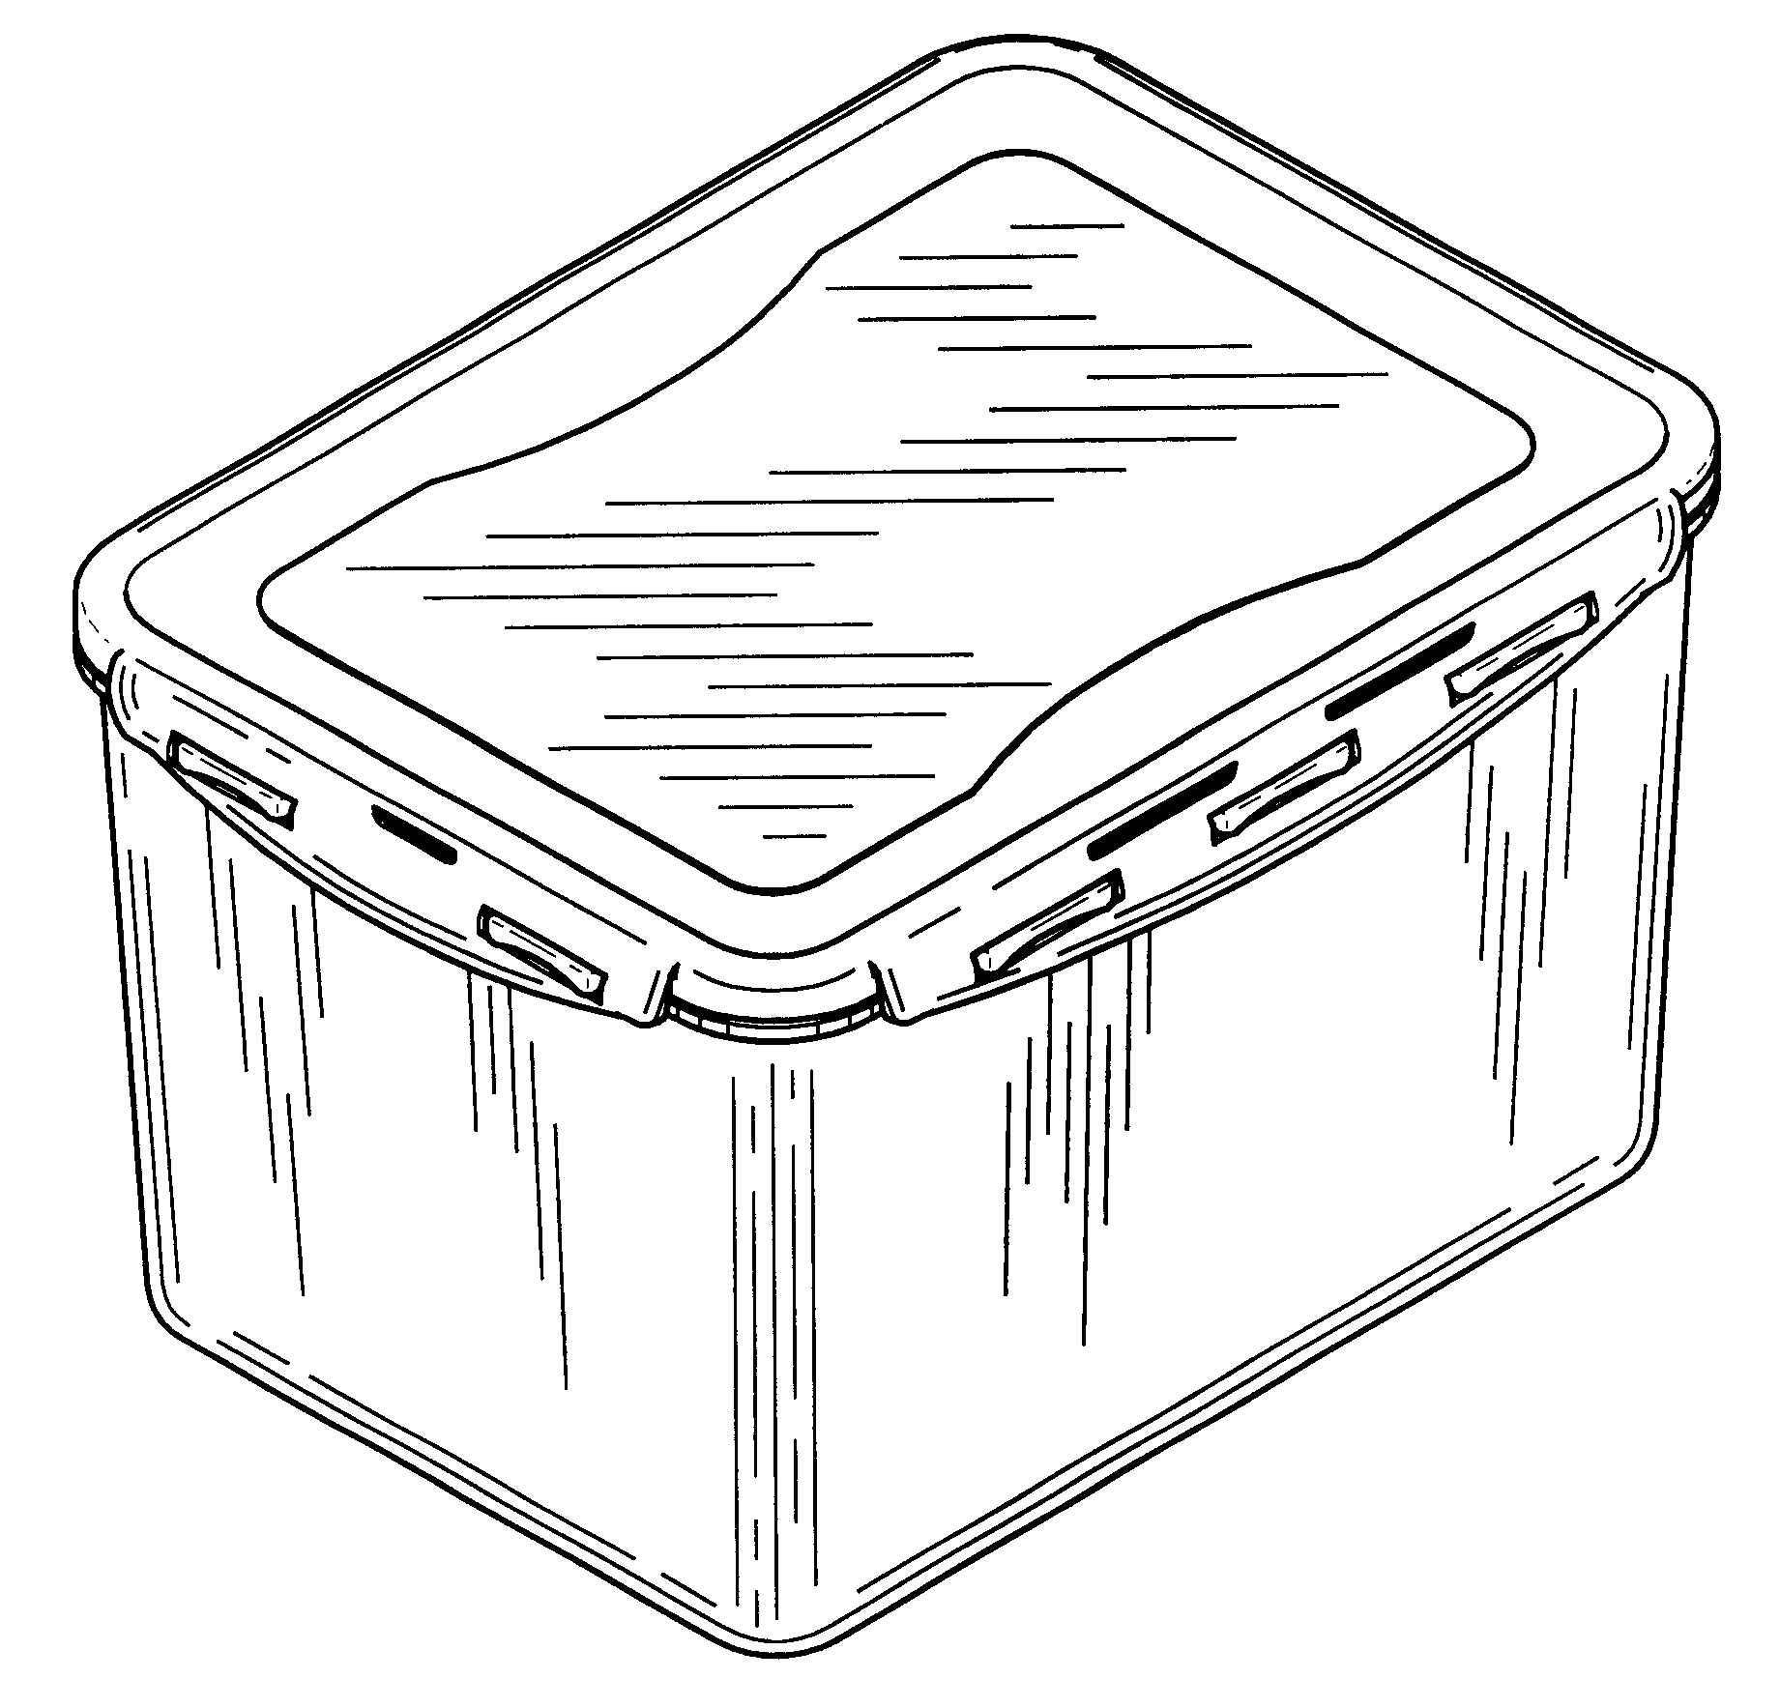
Store in appropriate containers
Containers:
Must be impervious to liquids
Easy to wash
Durable
Easy to handle
Notes:
Trainer to discuss:
Benefits of having containers in good condition
Easy to clean
Lightweight
Uniform sizes
Easy to cover.

Slide 27
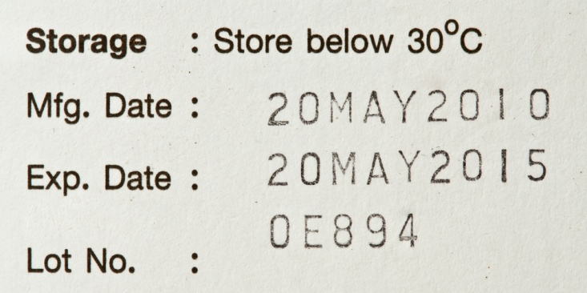
Labelling
Easy to read
Name of product
Date of manufacture
Use by date
Person responsible for cooking
Sample only
Notes:
Trainer to discuss:
Requirements of good labeling

Slide 28
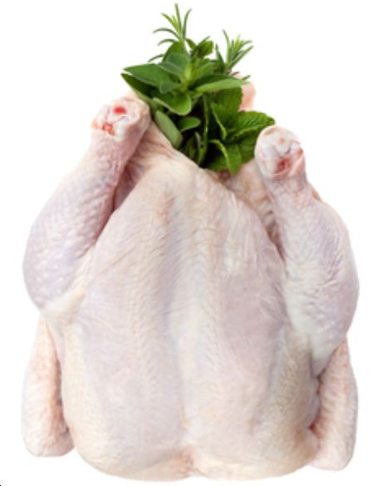
Ensure freshness
Life of product
When purchased
Storage conditions required
Requirements for storage
Notes:
Trainer to discuss:
Salient point in how to ensure the freshness of product
Fresh
Cooked
Long term and short term.
What is needed to deliver product to customer in optimum condition.

Slide 29

Thank you
Notes:
Thank you

